Slide 1
Level 400 on 425: ADAL to MSAL Migration
Den Delimarsky
Bogdan Alexandru Achim
Kyle Marsh

Slide 2
Why migrate ?
Continuous Access Evaluation
Proactive token refresh
Auth broker support
Device based Conditional Access policy – “Require managed device”
Auth Contexts
Token Protection Token protection in Azure AD Conditional Access - Microsoft Entra | Microsoft Learn (https://aka.ms/DevProtectToken)
Azure AD Certificate-based Authentication (https://aka.ms/IDDevCBA ) on Mobile
System browsers on mobile devices
Bottom line: Features and improvements are continuous across MSAL libraries.

Slide 3
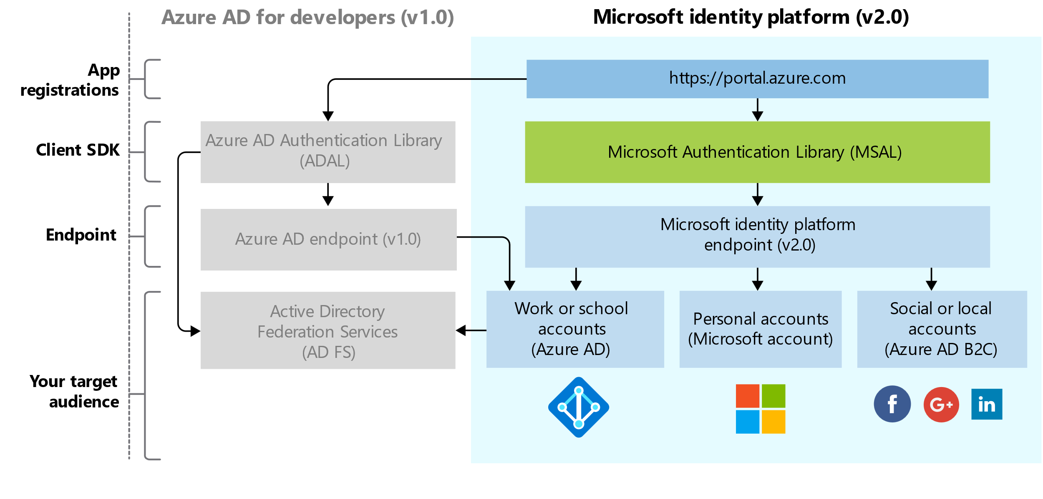
It started with a fundamental update of the platform

Slide 4
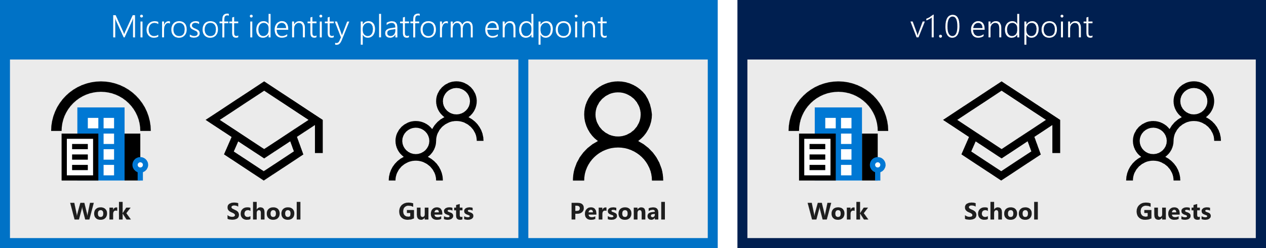
Who can sign in?

Slide 5
Consent user experience
ADAL is a static consent only experience
All “resources” have to be declared in the registration
All permissions are requested on first user and granted or denied as a group
MSAL is standards compliant and enables dynamic and incremental consent
Technically, no permissions are required in the registration, but highly recommended.
Makes it possible to have components of an app that can have separate consent.
For Line of Business apps, we do recommend admin consent.
Hence the recommendation for permissions in the app registration
Sophisticated component architecture still benefits from dynamic and incremental consent

Slide 6
Resources vs Scopes
ADAL apps ask for a token with the resource ID and the token is issued with the scopes in the app registration
https://login.microsoftonline.com/common/oauth2/authorize?
client_id=2d4d11a2-f814-46a7-890a-274a72a7309e
&resource=https://graph.microsoft.com/
MSAL apps request tokens with specific scopes
https://login.microsoftonline.com/common/oauth2/v2.0/authorize?
client_id=2d4d11a2-f814-46a7-890a-274a72a7309e
&scope=https://graph.microsoft.com/directory.read%20https://graph.microsoft.com/directory.write
More compliant with OAuth2 spec and common industry practices

Slide 7
AuthenticationContext vs Client Applications
ADAL has an AuthenticationContext class
Handles all types of applications
MSAL has a collection of client applications
Public client application are used for apps on devices, desktop computers, web browsers. Can’t keep secrets.
Confidential client applications run on servers. They are considered difficult to access and can keep secrets.
Managed Identity applications run on server and use Managed Identities for Azure Resources. More secure, more resilient.

Slide 8
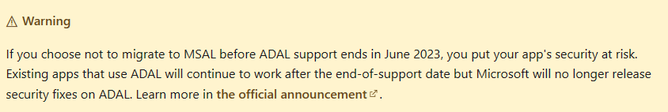
ADAL is not advancing
No new features have been added to ADAL since June 30, 2020.
There are no ADAL feature releases planned.
There are no new platform version releases planned.
Update your applications to use Microsoft Authentication Library and Microsoft Graph API - Microsoft Community Hub (https://aka.ms/IDDevEOY)
Support will direct you to upgrade to MSAL as a first step.
From July 2023 this will be only option.

Slide 9
What happens?
In June 2020 we announced the 2-year end of support timeline for ADAL.
In December 2022 we decided to extend the ADAL end of support to June 2023.
Until June 2023 we will continue informing customers about the upcoming end of support along with providing guidance on migration.
June 30th 2023 we will officially sunset ADAL, removing library documentation and archiving all GitHub repositories related to the project.
https://aka.ms/adal-eos

Slide 10
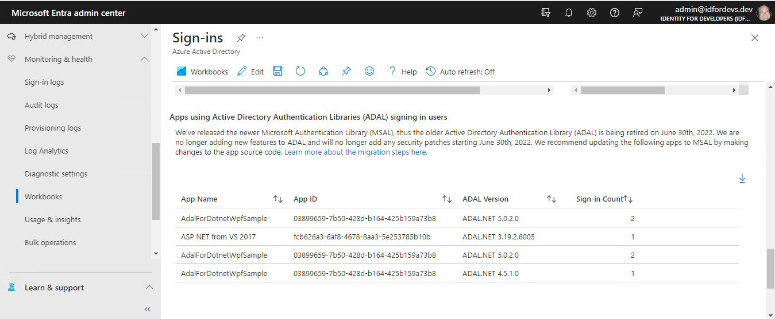
How can you find the ADAL apps in your tenant ?
Sign in workbook - good place to start

Slide 11
Each MSAL platform version has a migration guide. https://aka.ms/IDDevMigrate
Single-page app (SPA)
ADAL.js to MSAL.js
Web app
ADAL Node to MSAL Node
ADAL.NET to MSAL.NET
Web API
ADAL Java to MSAL Java
ADAL Python to MSAL Python
ADAL.NET to MSAL.NET
Desktop app
ADAL Java to MSAL Java
ADAL Python to MSAL Python
ADAL.NET to MSAL.NET
Mobile app
ADAL.Android to MSAL.Android
ADAL.iOS to MSAL.iOS
Xamarin Android using brokers to MSAL.NET
Xamarin iOS using brokers to MSAL.NET
Service / daemon app
ADAL Python to MSAL Python
ADAL.NET to MSAL.NET
ADAL Node to MSAL Node
ADAL Java to MSAL Java

Slide 12
Let's look at some MSAL.NET examples

Slide 13
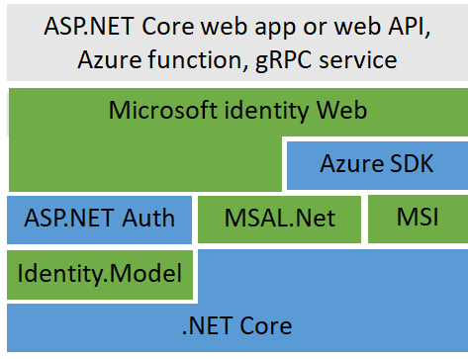
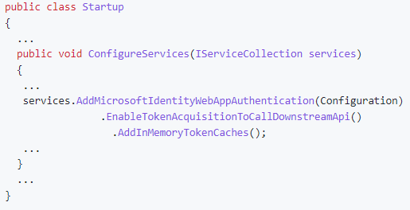
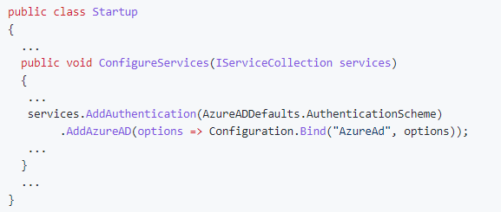
Microsoft Identity Web
A member of the MSAL “family”
The glue between many components
A higher-level library

Slide 14
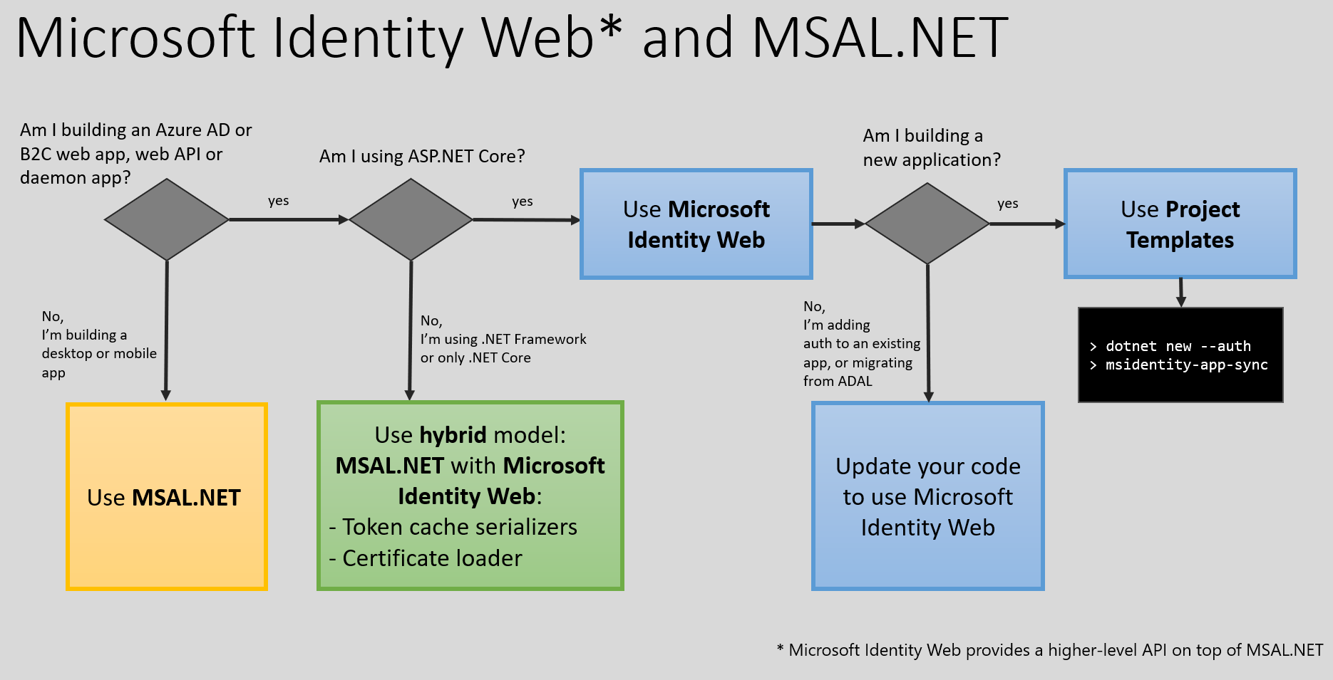
More options for ASP.NET Core WebApps and APIs

Slide 15
Migration help
Post your question on Microsoft Q&A and tag it with [azure-ad-adal-deprecation].
Open an issue in the library's GitHub repository. See the Languages and frameworks section of the MSAL overview article for links to each library's repo.

Slide 16
Questions?

